Slide 1


Chowgacha-Jhenaidah model is the best example of community participation
Dr. Md.Emdadul Haque
Ex Senior Consultant (Obs&Gyne)
Jhenidah Sadar Hospital

Slide 2
Comparative data of health facilities of different country of the world
SL NO | Country | Per capita health Expenditure per year by Govt. ($) | Doctors per 10000 Population | Nurse per 10000 Population | Beds per 10000 population | Out of pocket expenditure
01 | USA | 10246 | 29 | 119 | 29 | 11.08
02 | UK | 3860 | 28 | 82 | 25 | 14.79
03 | Malaysia | 384 | 15 | 35 | 19 | 36.67
04 | Sri Lanka | 159 | 10 | 21 | 41 | 38.43
05 | India | 69 | 7. | 17 | 5.3 | 65.06
06 | Nepal | 48 | 7.5 | 31 | - | 60.41
07 | Pakistan | 45 | 9.8 | 7 | 8 | 66.49
08 | Bangladesh | 37 | 5.3 | 4 | 8 | 67
World Bank 2018

Slide 3
A Hospital with a Vision …
Maximum utilization of Govt.
resources with
honesty and sincerity.
Integrated approach of
Administration, Community
Leaders .
Providing Effective services
through improved
management system.

Slide 4





CHOWGACHA UHC-Through the Ages
Old UHC
Old UHC
31-bedded UHC
50-bedded UHC

Slide 5


Blood donation program stared in 16 December, 1996 in Chowgacha UHC
A seminar on ‘Importance of birth & death registration and prevention of early marriage’ at Chowgacha Degree College in June, 1997. DC Jessore was the chief guest.

Slide 6




Beautification of the Premises

Slide 7


Innovations of Chowgacha Health Complex
Cycle stand near the entrance
“Pushti Tray” – Nutritional Education

Slide 8

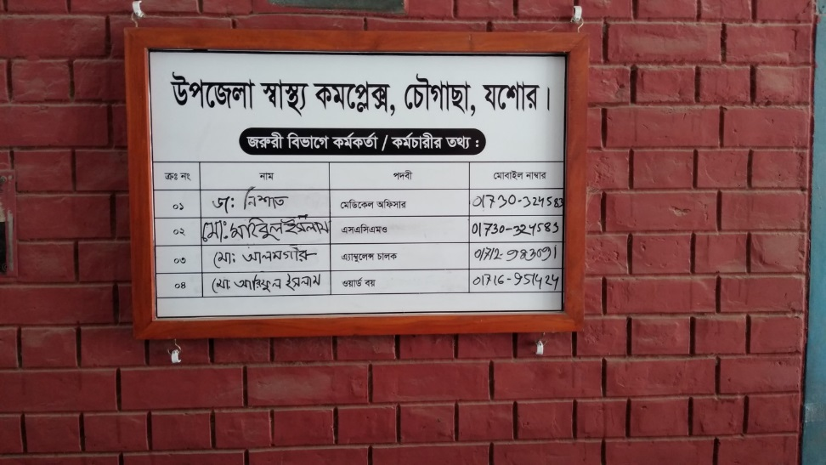
Innovations of Chowgacha Health Complex
Rest room for pregnant mothers
Cell phone-based Health Service

Slide 9
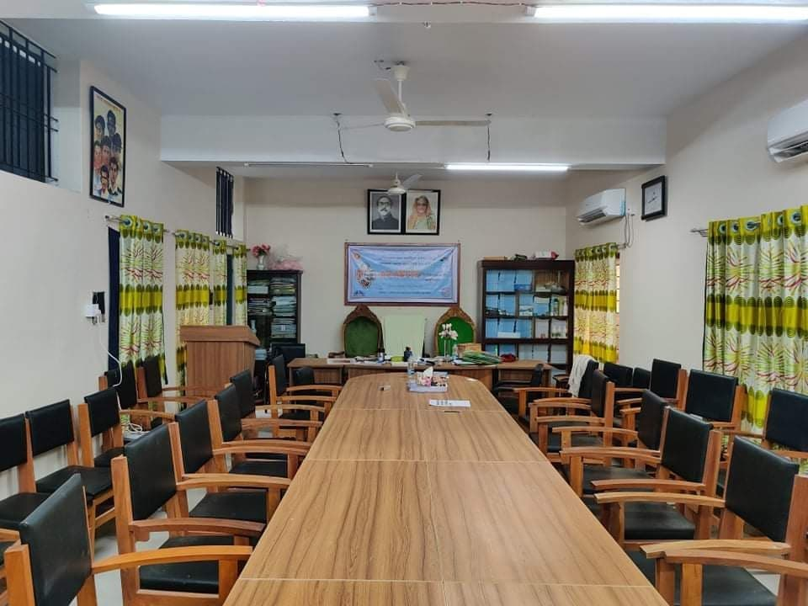
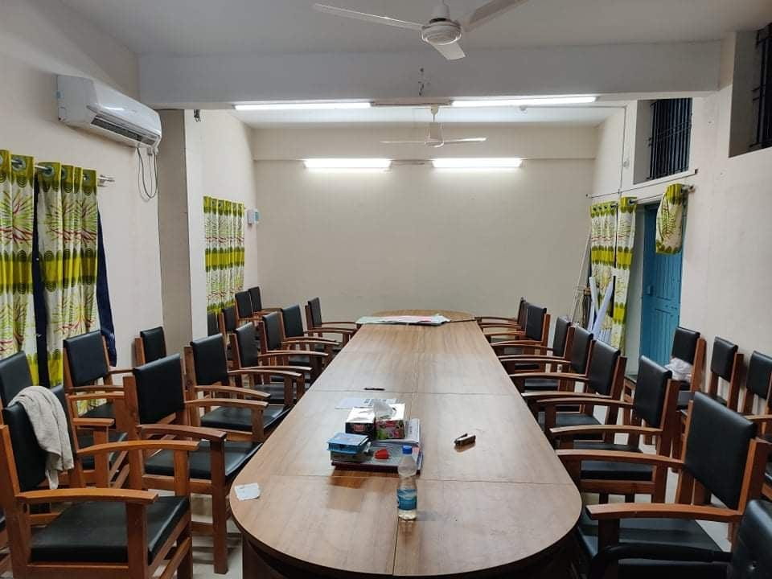
Newly Decorated Conference Room

Slide 10

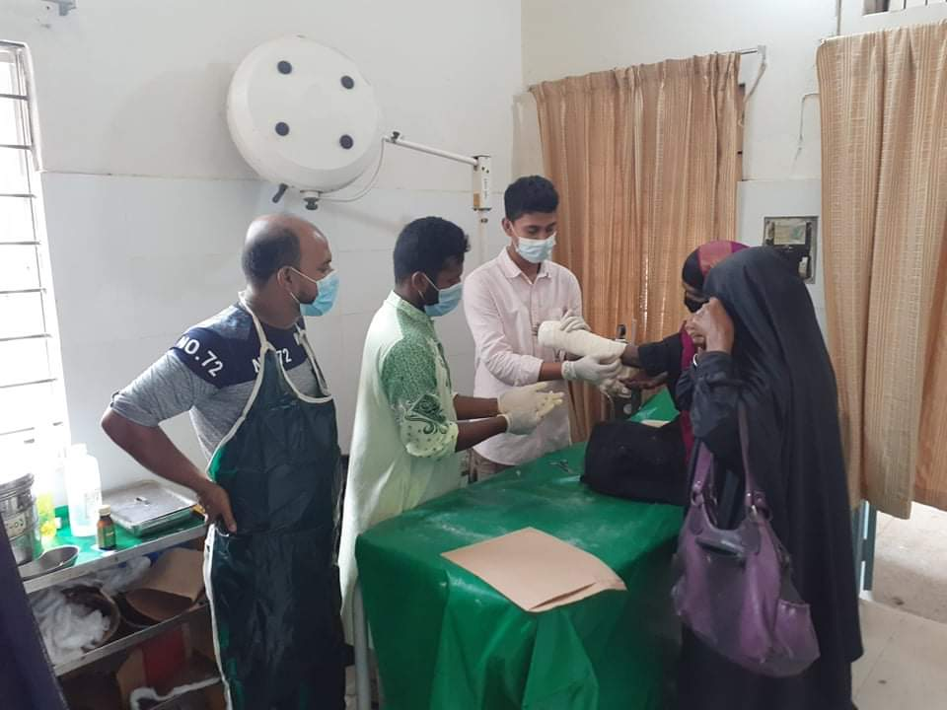
Daily Activities
Separate line for females
Developed ER with Sterile Workplace

Slide 11
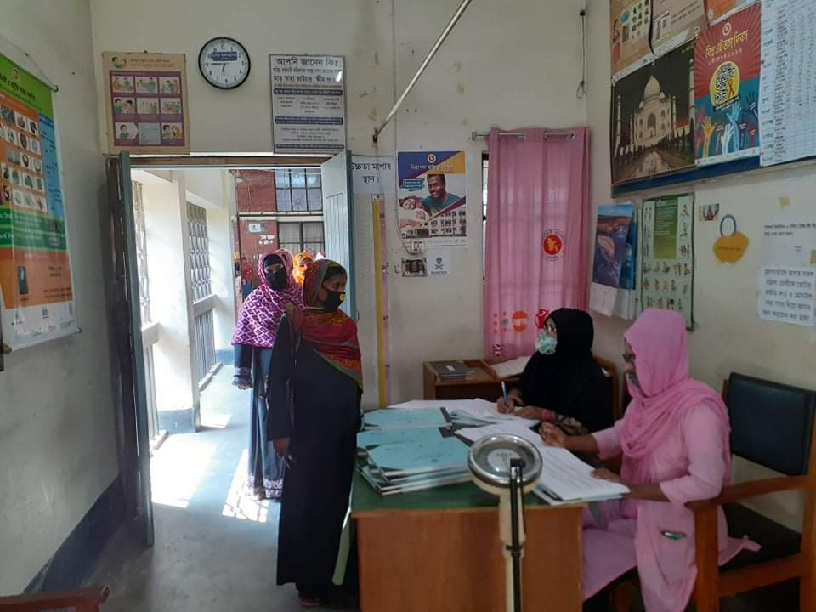
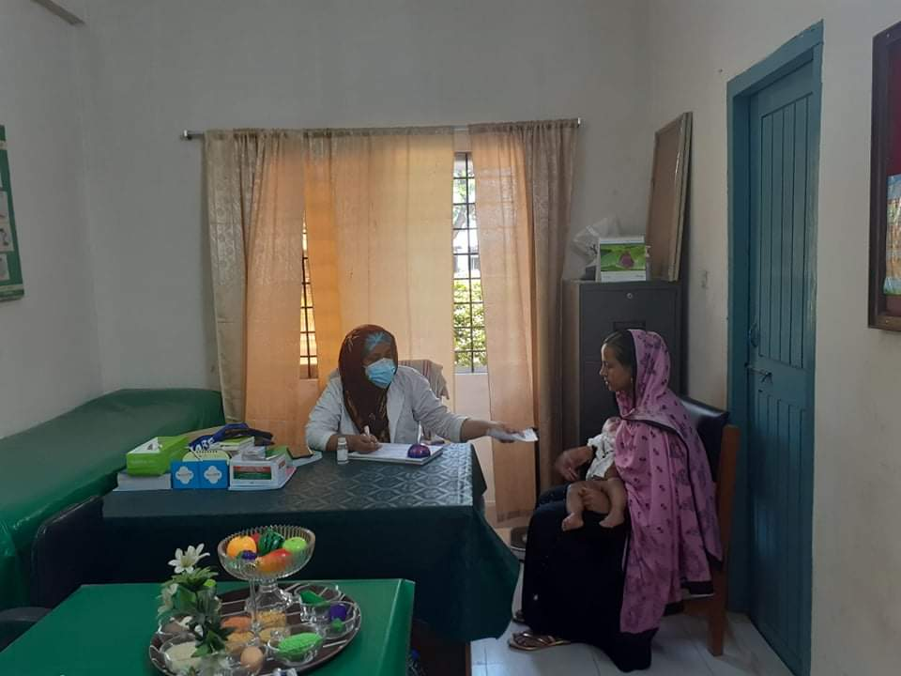
Daily Activities
ANC Corner
IMCI corner

Slide 12
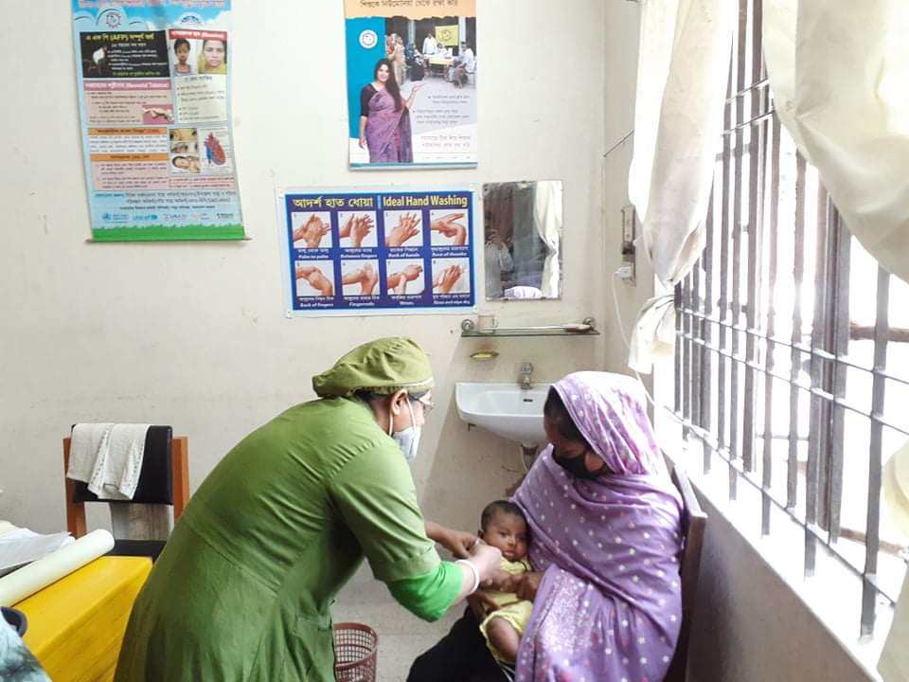
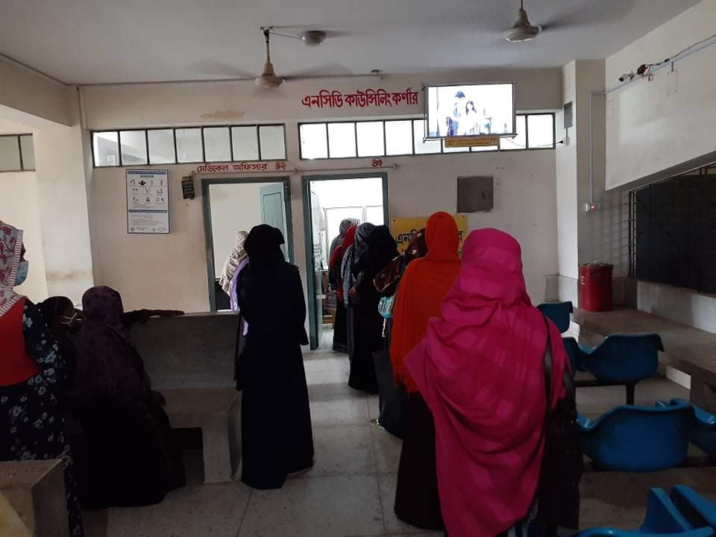
Daily Activities
Breast feeding & EPI Corner
NCD Corner

Slide 13
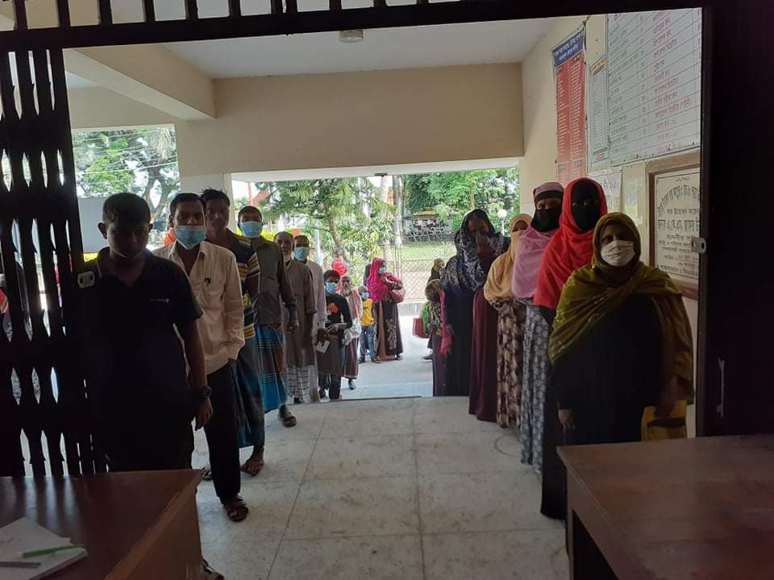
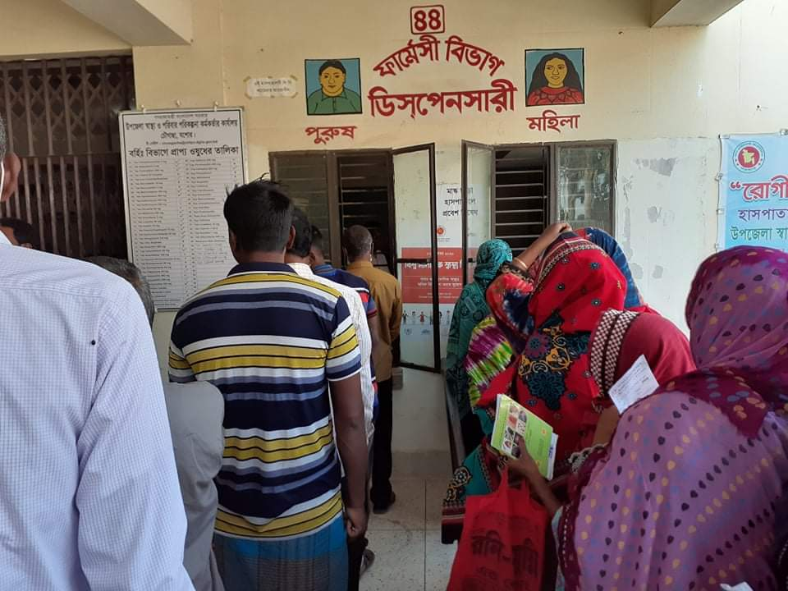
Daily Activities
Separation of male and female patients in Outdoor
Dispensary with separated male and female

Slide 14

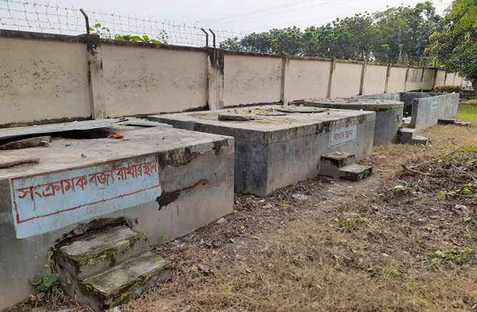
Daily Activities
Labour Ward with 41=(11+30) beds
Developed Waste Management System

Slide 15


Citizen Charter

Slide 16

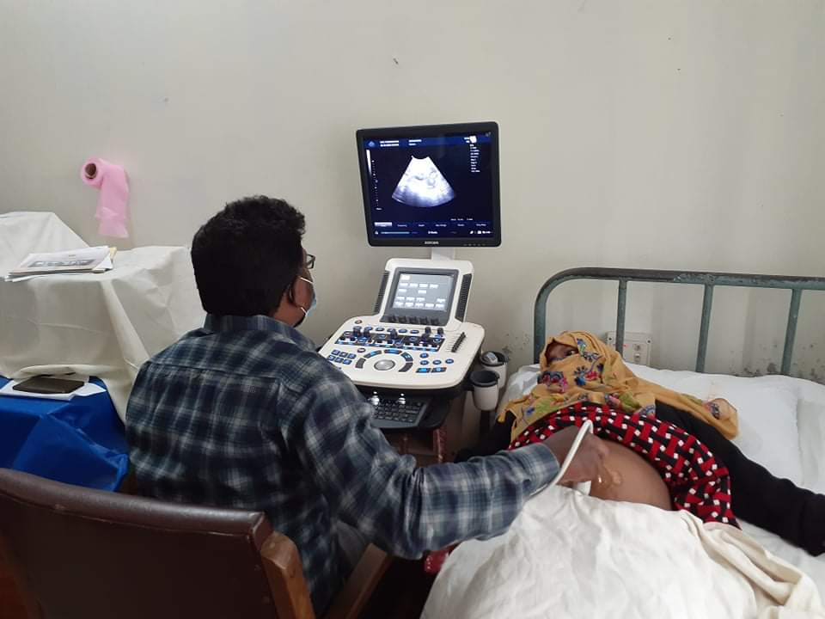
Community Participation
Volunteer working in Reception desk
Ultrasonography machine donated by the Upazila Porishod

Slide 17
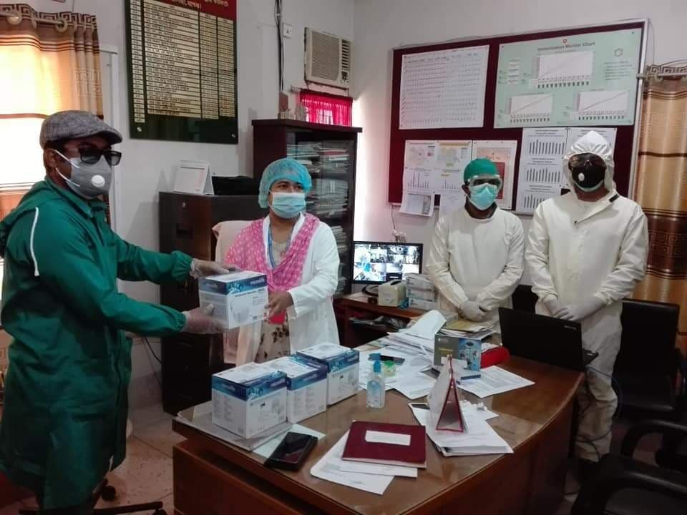
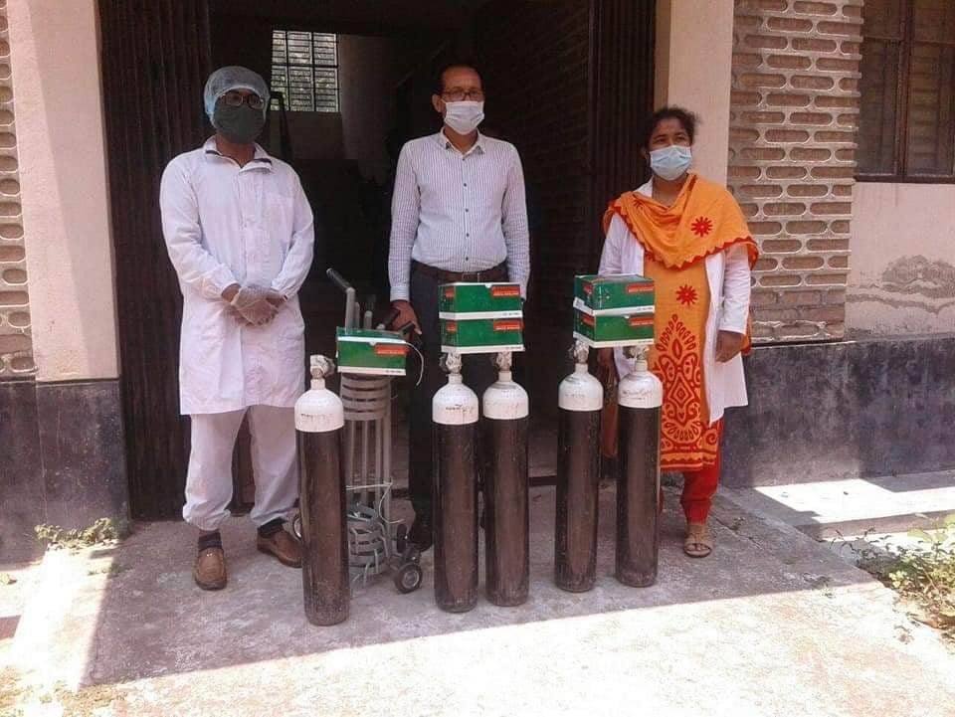
Community Participation
Nebuliser donated to the hospital by Upazila Porishod
Oxygen Cylinders donated by Upazila Porishod

Slide 18


Visit by Dignitaries – UHC Chowgacha
Honorable Health Minister Prof Dr. Ruhul Haque
MP with WHO Representative handing over
money and gift of voucher scheme of DSF
Secretary of MOHFW A.K.M. Zaforullah Khan
declared “Chowgacha UHC model” in DSF
voucher distribution ceremony on 20 June-2008

Slide 19
Background History of Chowgacha Health Complex Model, Jessore
Basically started in 1995.
Effectively started in Feb. 1996.
From January 1995 to 1997 JICA helped by Frontline MCH Program by giving technical and logistic supports.
Since 1998 DGHS & UNICEF have continued the support.
<4 Special activities>
ANC-Corner
Basic EOC service
Under 5 corner for under 5 children
Monthly birth and death record

Slide 20
Background History Contd.
November 2000 started Comprehensive EOC program
April 2007-Demand Side Financing (DSF) program started.
Hospital declared as model health complex on 20 June 2008 and upgraded to 50 bedded hospital by MOH&FW.
“Chowgacha health complex Model is replicable through out the country” Declared by Dr. Margaret Chan, D.G. WHO on 8th March 2010.
Piloting to replication C-J model launched in 10 district hospital by HEU of MOH&FW in 2016.
Prime minister's office issues order to replicate the model throughout the country in2017.
DGHS started to replicate C-J model in all upazilla UHC & DH in june 2018.

Slide 21



Slide 22

Upazila Health Complex
CHOWGACHA , JESSORE.
EOC Activities : 1997- 2011 (Hospital Delivery )

Slide 23

Upazila Health Complex
CHOWGACHA , JESSORE.
EOC Activities : 2000 - 2011 (Caesarian Section)

Slide 24
EOC Activities : 2011- 2020 (Total Hospital Delivery & C-section )

Slide 25
Comparative Data of Delivery of best performing EOC center of Khulna Division in 2011,2017,2019
 |  | 2011 |  | 2017 |  | 2019
SL No | Name of institute | C. Section | Total | C. Section | Total | C. Section | Total
01 | Khulna Meidcal College Hospital | 1356 | 3013 | 1228 | 2683 | 1828 | *4362
02 | Jashore Meidcal College Hospital | 1498 | 2852 | 1778 | 2967 | 1503 | 3078
03 | Kustia Meidcal College Hospital | 915 | 2677 | 1030 | 2781 | 1616 | 3674
04 | 100 bed,Jhenaidah Sadae Hospital | 430 | 2375 | 1143 | *2997 | 1019 | 2753
05 | Chowgacha UHC | 1007 | *4413 | 759 | 2922 | 854 | 2957

Slide 26
Upazila Health Complex
CHOWGACHA , JESSORE.
Comparative Data of Delivery of best performing EOC center of Khulna Division in 2011
SL No | Name of institute | NVD | Vacuum Del. | V. Breech | C. Section | Total
01. | Chowgacha UHC | 3346 | 34 | 26 | 1007 | 4413
02. | Ad-din Hospital Jessore. | 1124 | 0 | 0 | 1864 | 3492
03. | Khulna Medical College Hospital | 1581 | 58 | 18 | 1356 | 3013
04. | 250 bed Hospital, Jessore | 1327 | 2 | 25 | 1498 | 2852
05. | 250 bed Hospital, Kustia | 1728 | 0 | 34 | 915 | 2677

Slide 27
Emergency + Outdoor & Indoor 2011-2020
UHC Chowgacha

Slide 28
Bed Occupancy Rate (in percentage) of Chowgacha UHC

Slide 29
EOC Activities Chowgacha UHC 2011-2020
EOC Activities : 2011 – 2020 (ANC First Visit)

Slide 30
Community Participation in Chowgacha UHC
32 Human resources support (by service providers, Pouroshova and others).
Upazilla Porishod, Pouroshova, Devine Group and elite persons involvement.
USG machine donated by Upazila Porishod and honorable MP.
Dengue Disease control and VIA program supported by Devine Group.
Blood donation by the community.

Slide 31
Upazilla Health Complex
CHOWGACHA , JESSORE.
COMMUNITY SUPPORTED MANPOWER
TOTAL :46
  Volunteers :26
  Cleaners & guards :16
  Others :04
  The remunerations come from
  Outsourcing :25
  Service provider :21
  The amount of remuneration ranging from 200/= To 8000/=tk. Per month depending upon the style of work, which costs a total of nearly 90,ooo/=Tk per month.

Slide 32






Slide 33
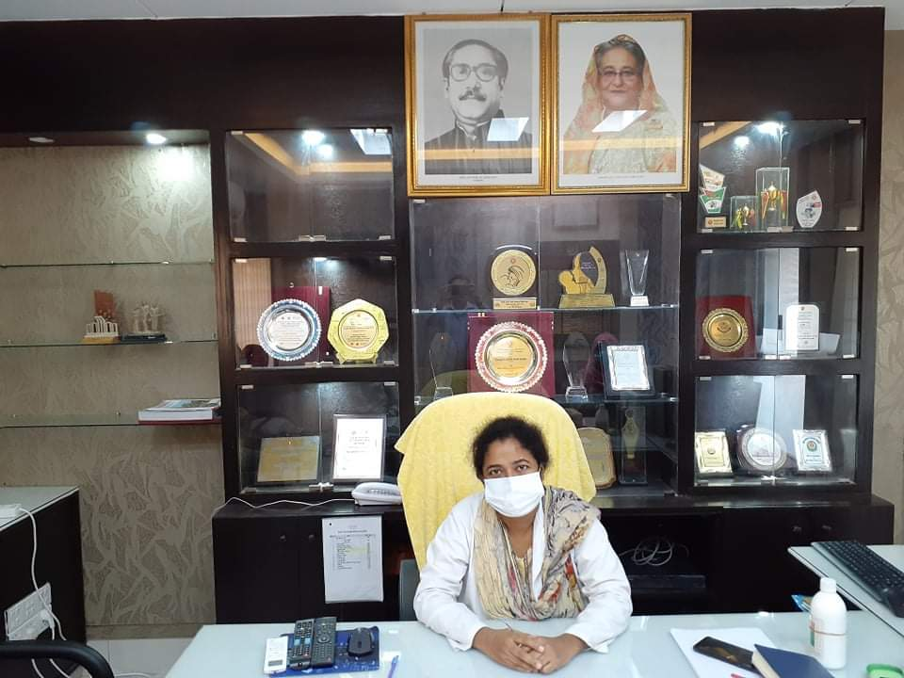
ACHIEVEMENTS of CHOWGACHA HEALTH COMPLEX
In 2008, Chowgacha Health Complex declared as the Model Upazilla Health Complex
  EOC Beds increased from 11 to 41
  Chowgacha UHC achieved MDG target in 2009
  Chowgacha UHC became the Best EOC center with 98.4% delivery rate in 2011
  Chowgacha Health complex is awarded for best performance in EOC form 2005 to 2014
  Achieve Health Ministers Award for its best performances in 2017 and 2018
  The UHC starts upgrade to 100 bedded hospital
  The UHC model is being replicated throughout the country by MOH & FW since 2016 by the order of Prime Ministers office

Slide 34

100 kh¨v wewkó m`i nvmcvZvj, wSbvB`n

Slide 35

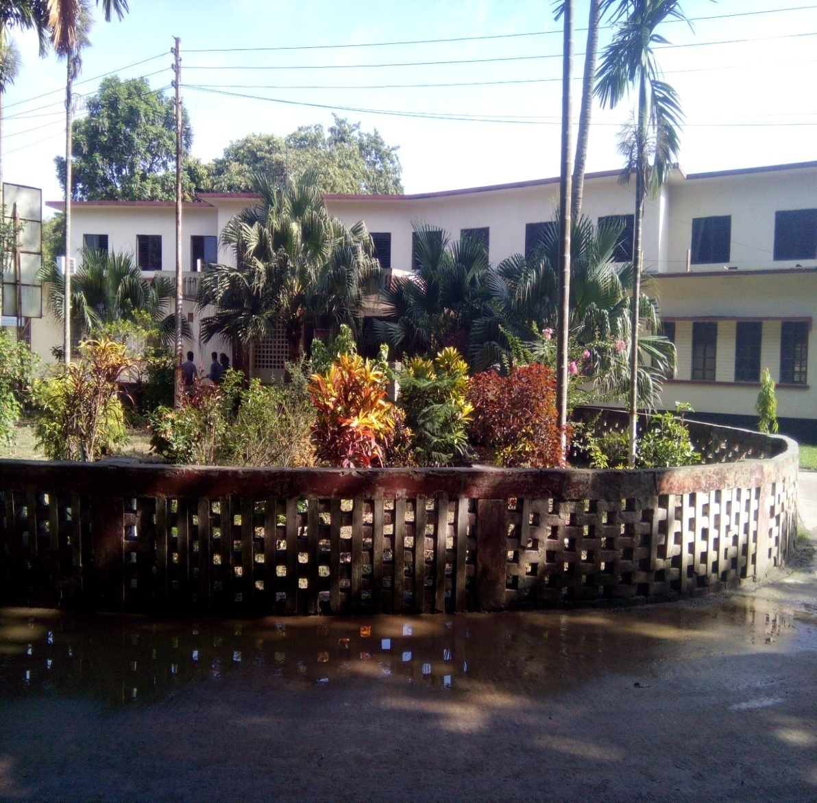

সদর হাসপাতাল,ঝিনাইদহ
পুরাতন ভবন - ১০০ শয্যা
নতুন ভবন ২৫০ শয্যা হাসপাতাল, ঝিনাইদহ

Slide 36
Challenges of the hospital in 2012
Insecure hospital environment.
Performance of all activities was very low.
Very limited support staff.
Receiving money from the patients by non-gov. staff.
Waste management system was poor.
Monitoring meeting was not performed regularly

Slide 37

Sadar Hospital, Jhenaidah
Bed Occupancy Rate from 1998 to 2020

Slide 38


Emergency + Out Door & Indoor Service 1998 to 2020
Emergency + Outdoor visit, Indoor (admission)

Slide 39
Operation Service (Major) 2011 to 2020
Sadar Hosital, Jhenaidah

Slide 40
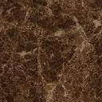
Sadar Hospital, Jhenaidah
Admitted Under 5 children in indoor from 2014 to 2020

Slide 41
Total ANC and Delivery in Jhenaidah District Hospital 2011-2020

Slide 42
Comparative data of revenue income (in Taka) from 2015 to 2020
Sadar Hospital, Jhenaidah

Slide 43
Comparative data of 4 best performing EOC Centre of Khulna division 2019

Slide 44
Covid-19 Admitted Patient Report 7/5/20 to 12/06/2021
Total possitive Jhenaidah District - 3037

Slide 45
Community Support System in Sadar Hospital
58 manpower (Cleaner 26, Ayah & ward boy 22, Guard 5, Volunteer 2, Trolley man 3 ) is supported by the community.
MP of Jhenaidah-2 donated 19 manpower support.
Chairman of Zahedee foundation supports 12 manpower and an intercom system, and a pickup for carrying oxygen with a cost of nearly 10 lac taka.
Mayor of Jhenaidah Paurasava plays an important role in security , cleanliness, repaired the boundary wall and supports 5 man power and and donation of a biochemistry analyzer at a cost of 1,15,000 Taka.
Biswas builders supports 7 manpower & doctors of the hospital and Jhenaidah town supports 10 man power.
Different kind of instruments donated by community leaders in Covid-19 situation .(About 70 lac taka)

Slide 46




Visit to Shatkhira District Hospital and Introduction of TQM activities

Slide 47




Changes in EOC Ward
Before
After
Before
After

Slide 48








Changes in Surgery & Pediatric Word

Slide 49




Waste Management & Campus Protection
Before
After
Before
After

Slide 50




Use of color code, alignment of picture & continuous big cleaning day
Color code
Color code
Alignment of pictures

Slide 51




Use of direction sign, labeling of rooms, clean latrine and waste segregation
Use of direction sign
Labeling of rooms
waist segregation
Clean latrine

Slide 52



Innovation in Medicine Ward

Slide 53




Innovative activities of Jhenaidah Sadar Hospital - 1
Reception room
Creation of nursing aid
Health education session
Community engagement

Slide 54




Innovative activities of Jhenaidah Sadar Hospital - 2

Slide 55




Innovative activities of Jhenaidah Sadar Hospital - 3

Slide 56




Innovative activities of Jhenaidah Sadar Hospital - 4

Slide 57




Innovative activities of Jhenaidah Sadar Hospital - 5

Slide 58




Involvement of MP, District Administrator & Mayor in Sadar Hospital

Slide 59




Involvement of district high officials in hospital activities

Slide 60



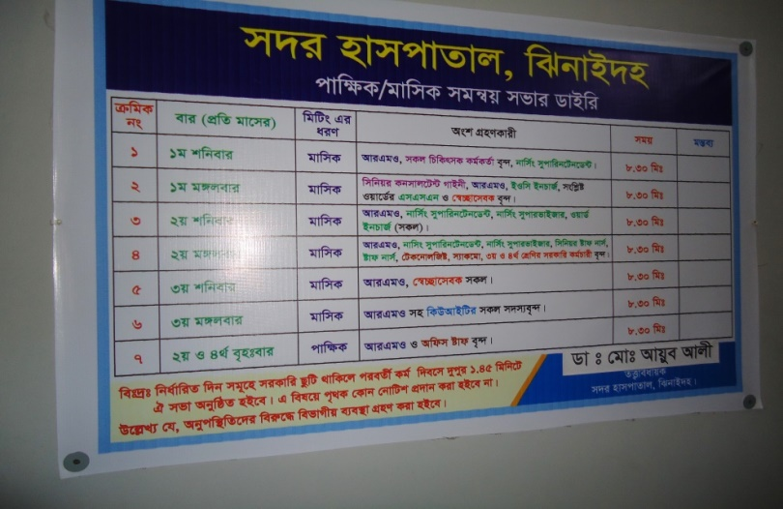
Internal Monitoring System
Meting of health improvement committee
Meting of community support group committee
QIC meeting
Monthly meeting schedule

Slide 61




Improved pediatric word by local initiative

Slide 62




Community participation during covid-19 management

Slide 63
Achievement of the Hospital
1. Active Community Participation in health service is an example in Bangladesh.
2. Improved performance of all services specially Pediatric, obstetric, operation
and outdoor service.
3. Improved Cleanliness and Beautification of Campus.
4.. The hospital is awarded 6 times from 2013 to 2018.
5. Improved Security.
6. Improved Financial Management
7. Replication of C- J Model by DGHS in 20 District hospital & 40 UHC of the country.
8. Nearly 70 lacks Taka support for 6 high flow oxygen nasal cannula, central oxgen supplying system , a pic up for covid patient

Slide 64

HSSI Health Minister’s National Award 2019

Slide 65

Thank You
আমাদের বাগানের ফুল
Notes:
65

Slide 66
Reason why Chowgacha Health Complex is Model-1
Successful leadership in health management
All the Components of Primary Health Care are successfully implemented here
Personal and group skills in health care
Community engaged health management
Optimum use of government resources
Effective relation with local administration and with other government organizations
Improvement of security by community engagement
Improved maternal and child health care activities
Ensuring corner-based health care
Woman and Baby Friendly Hospital.

Slide 67
Reason why Chowgacha Health Complex is Model-2
Birth and death recording, progress assessment and accountability by collecting information on all health indicators
Improving healthcare by unit management
Health awareness by health education in outdoor, indoor, ante-natal registration room and pregnant women restroom
Cleanliness (Waste management) and beautification of the facility and premises
Provision of safe blood transfusion for emergency needs
Zero tolerance against corruption
Implementation of the 5S KAIZEN-TQM for the improvement of health care
Improved financial management by establishing cash counter

